Slide 1



Introduction to Artificial Intelligence and Machine Learning
Dr. Manju Venugopalan
Dept of CSE
ASC Bangalore

Slide 2
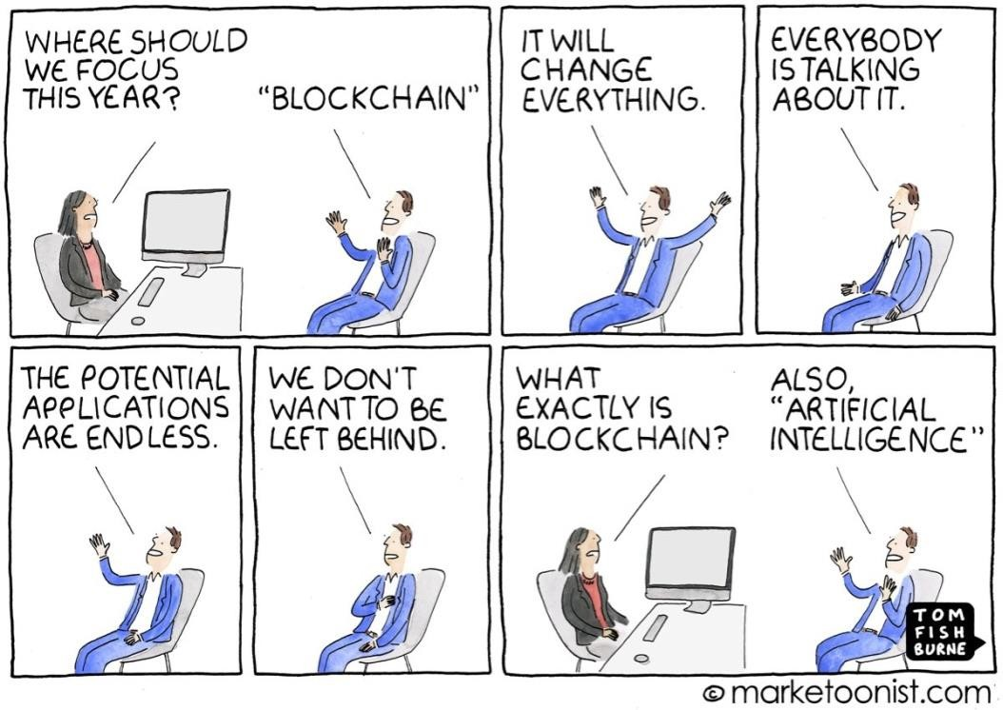
What makes us human ?
What makes us uniquely human?
We are intelligent, what then, is Artificial Intelligence ?

Slide 3

Human Intelligence
Senses
Discover
Infer
Reason
Transfer

Slide 4

Artificial Intelligence (AI)
AI -
Algorithmic strategies that try to match or exceed the capabilities of humans
Applications Domains:
Senses
Discover
Infer
Computer vision
Natural Language Processing Text to speech
Motion – Robotics
Reason
Transfer

Slide 5
Cognitive
Computing
Machine
Learning
Computer Vision
Artificial Intelligence
Neural Network
Natural Language Processing
Deep
Learning

Slide 6
Artificial Intelligence
Machine Learning
Supervised
Learning
Unsupervised Learning
Reinforcement Learning
Deep Learning

Slide 7
Machine Learning (ML)

Slide 8
Machine learning (ML)
Arthur Samuel coined the term in 1959
"Learning" Not explicitly programmed
Prediction or decisions based on data
More data – more accurate results
What, then, is deep learning ?

Slide 9
Deep Learning (DL)
Deep learning is a subset of ML
– Neural networks – Nodes and statistical relationships between nodes to
model the way our mind works
– One layer – Approximate predictions
Additional layers – Optimize and refine for accuracy
"Deep" - Multiple layers (More than 3 layers)
Eliminates some pre-processing
Better with unstructured data

Slide 10
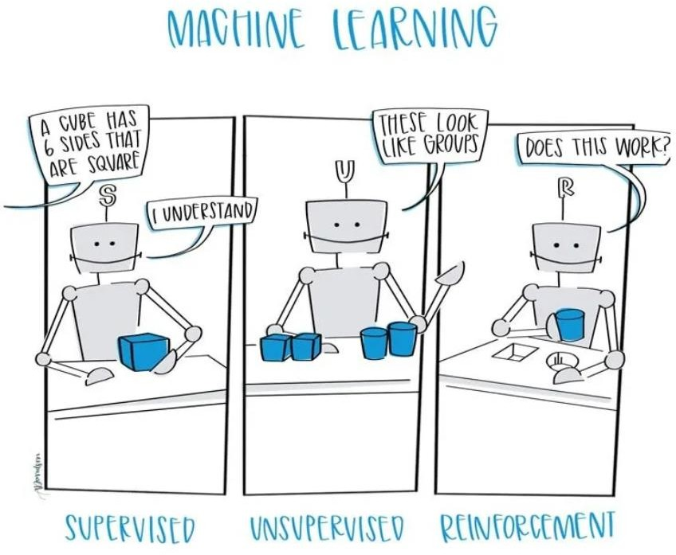

Slide 11
Artificial Intelligence
Machine Learning
Supervised Learning
Unsupervised Learning
Reinforcement Learning
Deep Learning

Slide 12
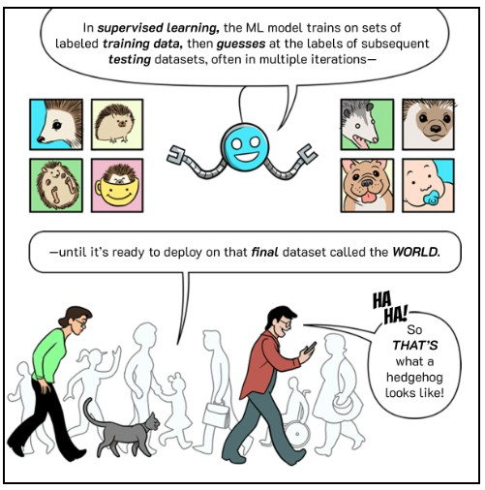
Supervised learning
Has a defined mapping from input to output
The model learns this mapping from paired input/output data examples

Slide 13
Some terms used
Regression - continuous numbers as output
Classification- discrete classes as output
Binary classification– two classes treated differently
Multiclass classification – Multiple classes treated differently

Slide 14
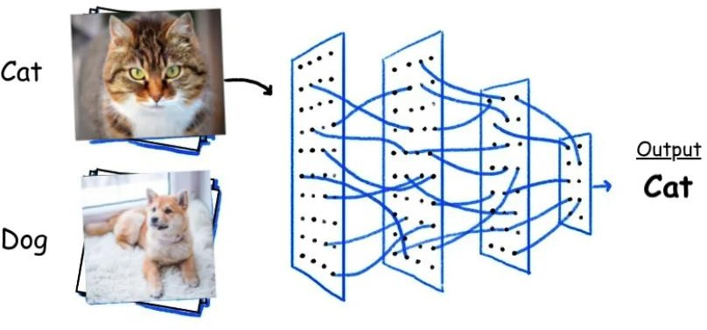
Image classification
Binary or multiple discrete classes
Defect detection
Security surveillance
Biometrics
Example Classifier:
Convolutional Neural Network

Slide 15
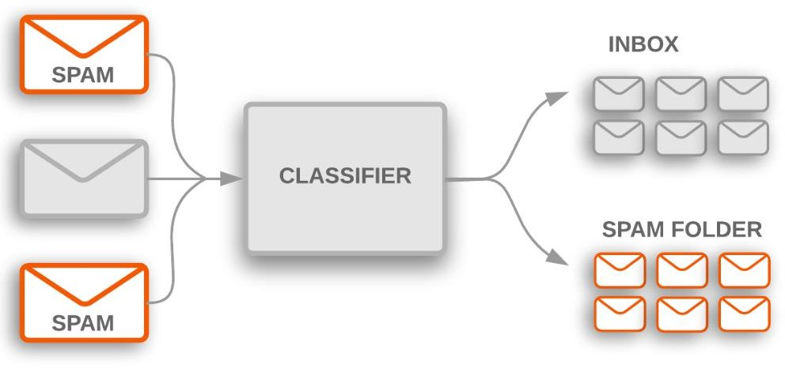
Text Classification
Spam detection
Movie / restaurant reviews
Binary classification (two discrete classes)
Naïve Bayes, Support Vector Machines (SVM)

Slide 16
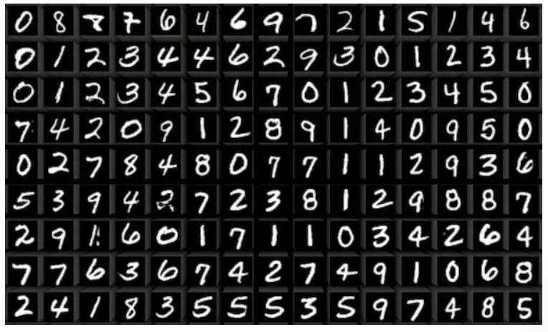
Handwriting Recognition
Postal addresses
Banking solutions
Example Classifiers
Convolutional Neural Networks (CNN),
Long Short-Term Memory Networks (LSTM)

Slide 17

Regression
Real value output
Housing rent calculation
Credit scoring
Stock price forecasting
Sales prediction
Linear Regression, Support Vector Regressor, Neural networks

Slide 18
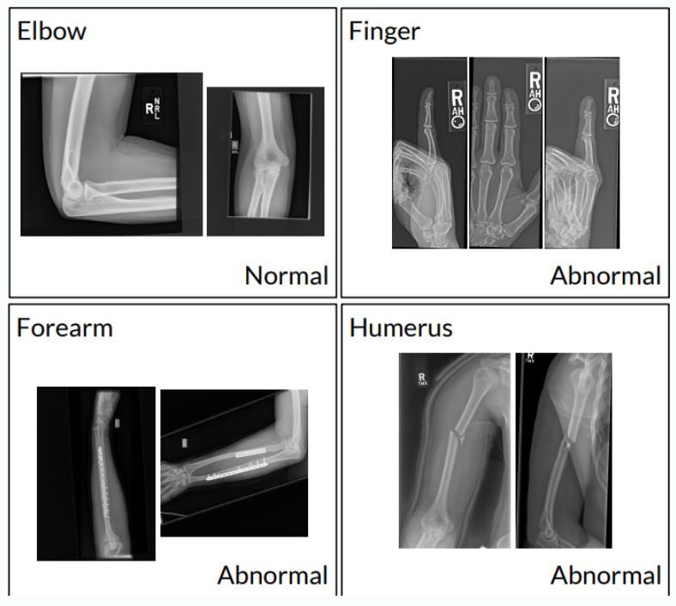
Medical Diagnosis
Classification – Binary or multi-class
Prediction of severity –
Regression
Image Segmentation – Tumor
Depends on the data and task
Classifiers
CNN, Random Forest(RF), SVM, LSTM, CNN-LSTM

Slide 19
Artificial Intelligence
Machine Learning
Supervised Learning
Unsupervised Learning
Reinforcement Learning
Deep Learning

Slide 20
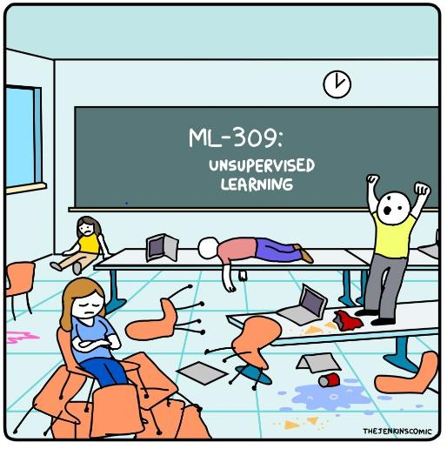
Unsupervised learning
Learning about a dataset without labels
Clustering
Finding outliers
Dimensionality reduction
Generating new examples
Filling in missing data

Slide 21
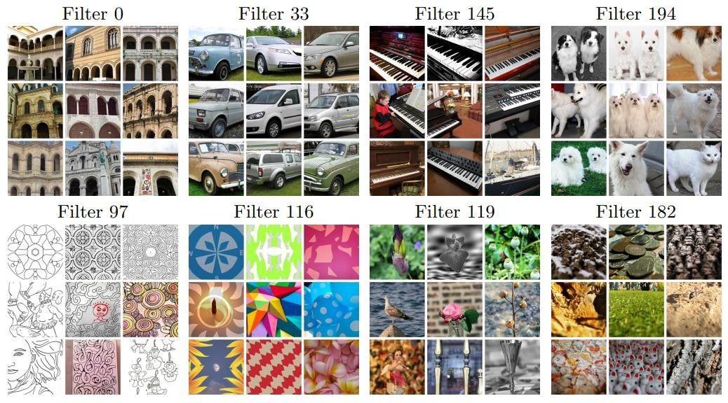
Clustering
Document retrieval
Customer preferences – Retail
Social media analysis
Find patterns in data

Slide 22
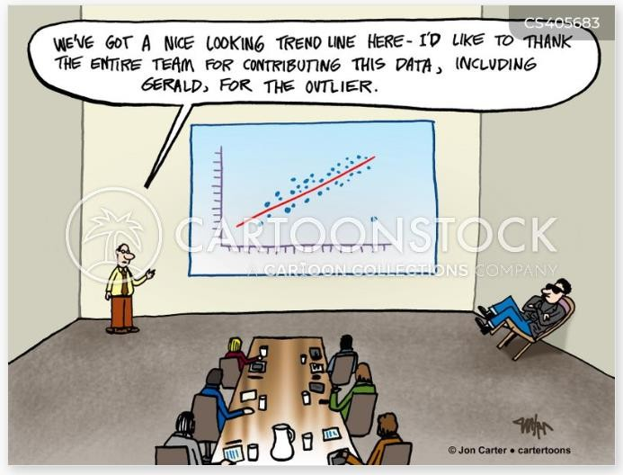
Finding outliers
Banking alert systems
Surveillance
Network traffic anomaly
Classifiers
SVM, Autoencoders

Slide 23
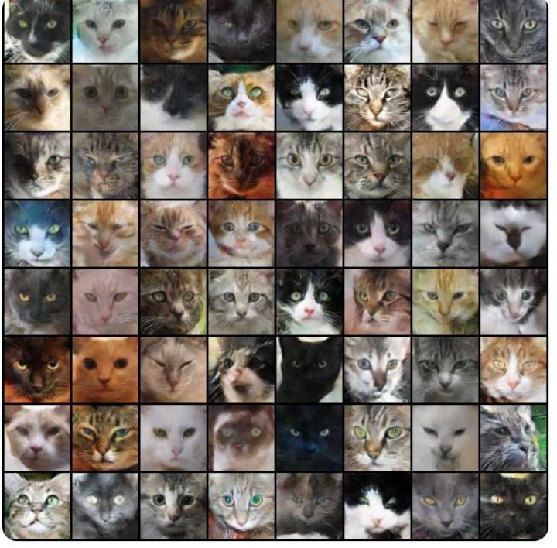
Meow Generator
Generated realistic images of cats in 2-3 hours
Used Cat dataset
(https://web.archive.org/web/20150703060412/http:// 137.189.35.203/WebUI/CatDatabase/catData.html)
Different types of GAN used in
a semi-supervised manner

Slide 24
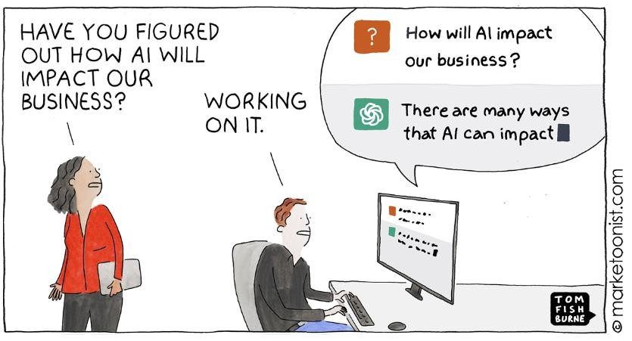
Generative AI : Some examples
Chat GPT, Bard
The search suggestion on internet browsers
Tools like Grammarly that suggest edits and text generation
Image generation (GANs)
Translations
Music generation – IBM Watson Beat
Art, video and game design
Data augmentation

Slide 25
Artificial Intelligence
Machine Learning
Supervised Learning
Unsupervised Learning
Reinforcement Learning
Deep Learning

Slide 26
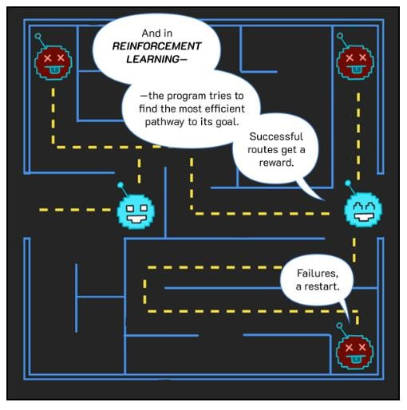
Reinforcement learning (RL)
A set of states
A set of actions
A set of rewards
Goal: take actions to change the state so
that you receive rewards
You don’t receive any data – you must explore the environment yourself to gather data as you go

Slide 27


Steps in implementing an AI model

Slide 28
Steps in implementing an AI model
Problem identification
Selection of appropriate data
Data pre- processing
Selection of AI model(s) based on data
Training and tuning the model
Testing the developed model
Analysis of the results
Re-iterate steps as needed
Deploy model

Slide 29
Problem identification & Data curation
Problem Identification
Data curation
Experts in the field
Personal experience
Literature survey
Data curation
Data collection in person
Public repositories
Private repositories
Simulated data
Synthetic data

Slide 30
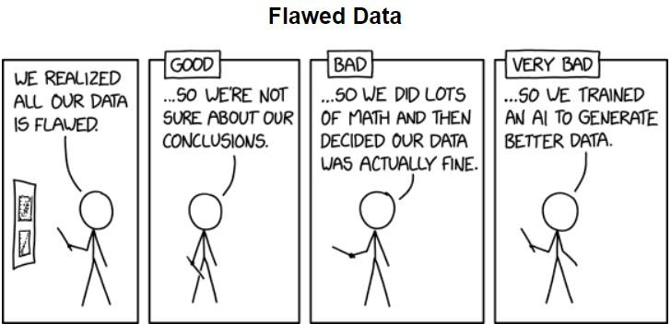
Data pre-processing
The specific steps depend on the type of data used
Size of the dataset
Visualize the data and labels
Data cleaning – Remove
duplicates or bad samples
Noise removal

Slide 31
Data pre-processing
– Distribution of data across the classes
Imbalanced data
results in a model biased towards the majority class
Data augmentation
Resizing the data to meet the model's requirements
Dividing the data into train, test datasets

Slide 32
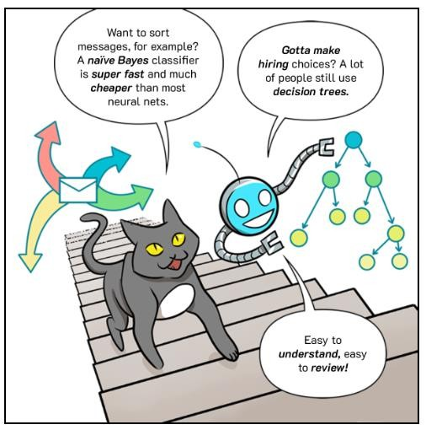
Choosing the AI model
Problem statement and type of data
Classification, Regression, Segmentation, Augmentation, Feature extraction, etc.
Time series – SVM, RF, LSTM, 1D-CNN, Images – SVM, CNN
Features – LR, SVR / SVM, RF, MLP, NB, DT
Computational capacity
Simpler model or may need dimensionality reduction
Try various models to choose best fit or go for ensemble
Source: https://cloud.google.com/products/ai/ml-comic-1

Slide 33
Training the model
The data split as part of the training subset is passed onto the chosen AI model
A small portion of the data is retained as the test
data, which is used to test the model's learning

Slide 34
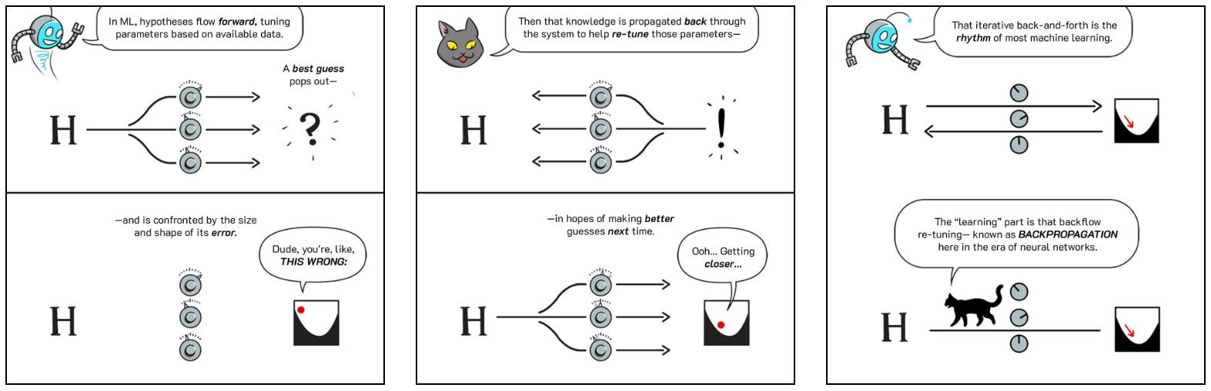
Training or "learning"

Slide 35
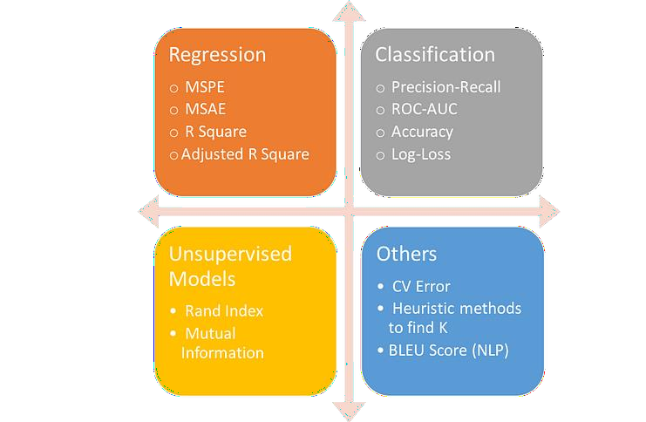
Testing the model
Choose model appropriate evaluation metrics
Testing on the hold-out data

Slide 36
Steps in implementing an AI model
Problem identification
Selection of appropriate data
Data pre- processing
Selection of AI model(s) based on data
Training and tuning the model
Testing the developed model
Analysis of the results
Re-iterate steps as needed
Deploy model

Slide 37
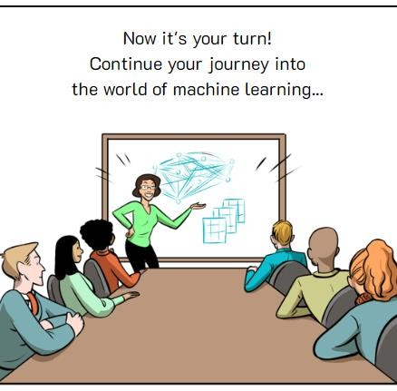
Thank you!

